Slide 1
Catalog and course change requests
SOUTHERN ILLINOIS UNIVERSITY

Slide 2
LEARNING OUTCOMES
At the end of this presentation, you will
Understand the different fields needed to Add, Drop, or Modify a course using a Form 90
Understand the different fields needed to complete a Form 90A and supporting documentation to edit a program’s catalog copy, major requirements, and update faculty list

Slide 3
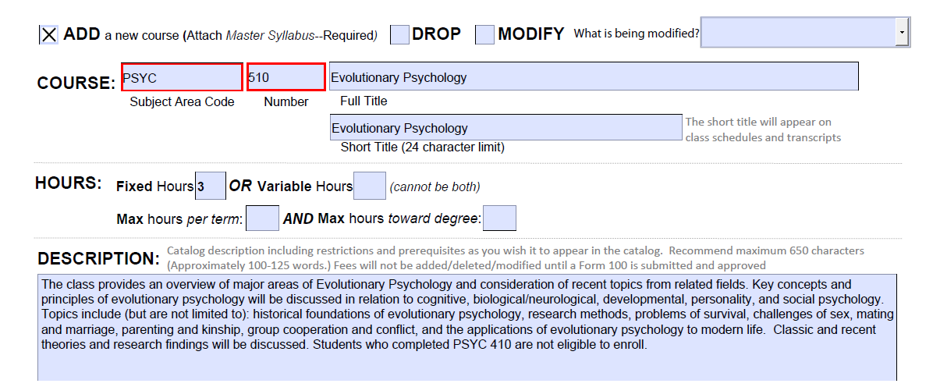
FORM 90 – ADD A COURSE
Confirm course number availability with the Registrar’s office. Contact information provided on final slide.
Submit a master syllabus with the Form 90. See the example provided on APAP’s website. Link provided in final slide.

Slide 4
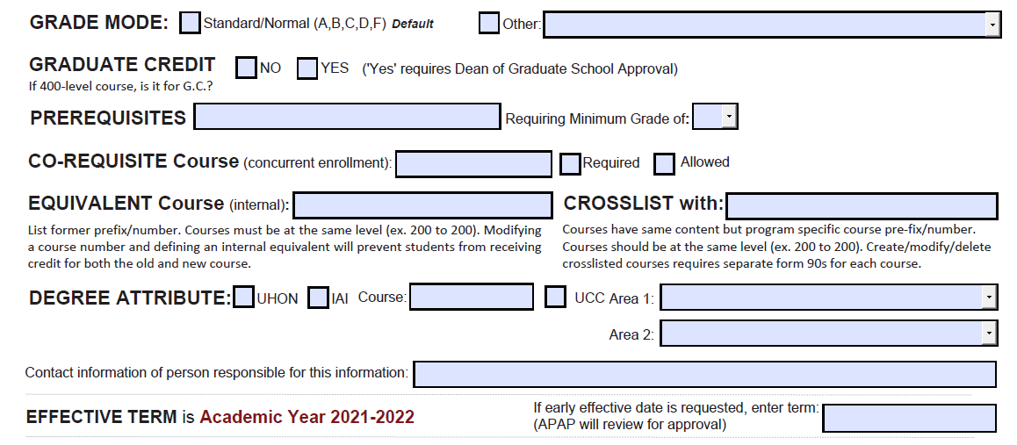
FORM 90 – ADD A COURSE
A Form 90 is required for any co-requisite or crosslisted course associated with the new course
Specify if the course is Honors, IAI, or part of University Core Curriculum
Specify the Effective Term

Slide 5
FORM 90 – DROP A COURSE
Provide course Prefix, Number, and Name
A Form 90 is required for any co-requisite or crosslisted course associated with the dropped course

Slide 6
FORM 90 – DROP A COURSE
Provide Effective Term
Signatures are required

Slide 7
FORM 90 – MODIFY A COURSE
Provide course Prefix, Number, and Name
Select the most accurate description from the dropdown menu

Slide 8
FORM 90 – MODIFY A COURSE
A Form 90 is required for any co-requisite or crosslisted course associated with the modified course
MHI 510

Slide 9
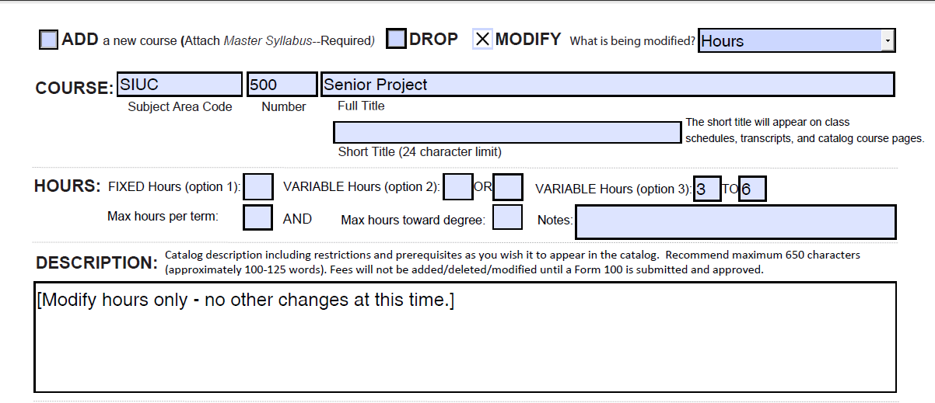
EXAMPLE OF COURSE MODIFICATION
To modify course hours, select ‘Hours’ from the dropdown menu. Update information and note that no other changes are necessary.

Slide 10
CO-REQUISITE, EQUIVALENT, and CROSSLISTED COURSES
CO-REQUISITE Courses that must be taken simultaneously.
EQUIVALENT Courses are the former course name/numbers. For example, ITEC 450 and IST 450. Form 90s are not necessary for inactive courses, but they should be listed here.
CROSSLISTED Courses meet at the same time and follow the same syllabi but have program specific names/numbers. For example, MHA 510 and MHI 510. Courses must be at the same level and course details must match. A Form 90 is required for all active crosslisted courses when a modification is made.

Slide 11
CO-REQUISITE and CROSSLISTED COURSES – ADDITIONAL DOCUMENTATION
When additional Form 90s are needed due to co-requisite or crosslistings for courses outside your program/department, please contact the appropriate chair/director to advise that Form 90s are necessary. Include a copy of your Form 90 and any supporting documentation for their reference.

Slide 12
SIGNATURES
Form 90s must contain all school/department and college-level signatures before submission to the APAP Office. APAP staff will gather all additional necessary signatures, including Graduate School dean.

Slide 13
FORM 90A
Use a Form 90A to
Edit a program’s catalog copy
Change program requirements
Update faculty listings

Slide 14
IDENTIFY PROGRAM TO BE EDITED
Specify catalog – Undergraduate or Graduate
Provide College (Unit) Name
Specify the degree to be edited
Provide the Major/Program to be edited
1
2
3
4

Slide 15
SUMMARY OF CHANGE
Updating faculty listing – please see attached PDF for revised faculty roster.
Include a simple description of the requested change.
Supporting documents – Word or PDF files – should thoroughly describe the requested changes. We recommend downloading a PDF of your current catalog page and using Adobe editing tools.

Slide 16
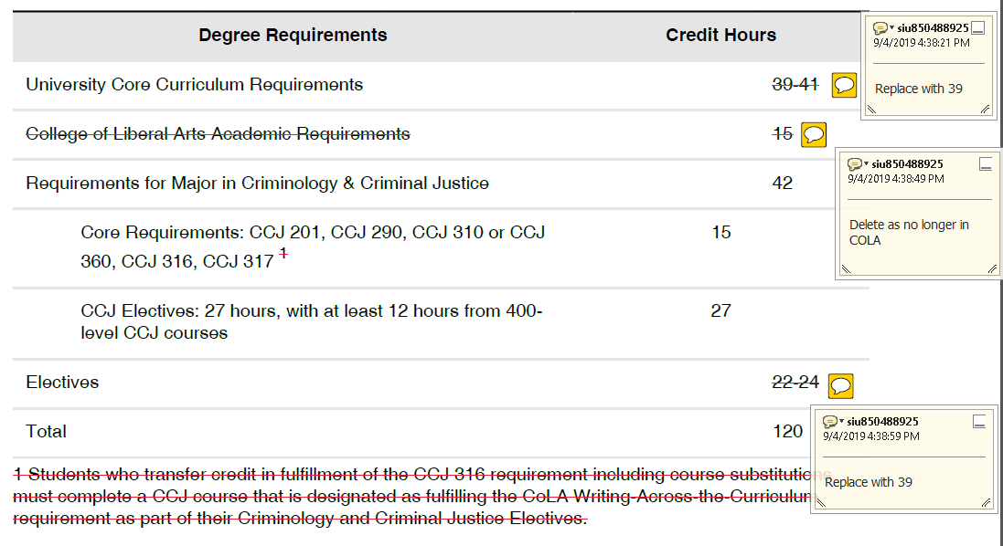
SUPPORTING DOCUMENTS – EXAMPLE 1
Download pages from catalog and edit using Adobe markup tools

Slide 17
SUPPORTING DOCUMENTS – EXAMPLE 2
Create a Word document and use track changes when editing.

Slide 18
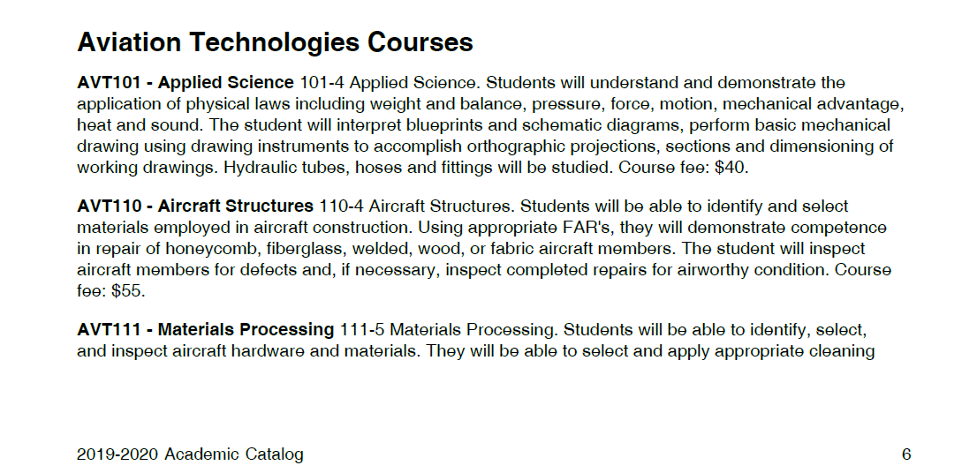
COURSE LISTINGS
The ‘Courses’ section of each catalog page is automatically populated from Banner. Edits for this section require a Form 90.

Slide 19
COMMON FORM ERRORS
Missing signatures – all unit-level signatures should be complete before submitting to APAP.
Support staff CANNOT sign ‘on behalf of’ a chair/director or dean.
Missing syllabi – required when adding new courses. See recommended master syllabi.
Graduate Credit – you must check yes or no. This prompts APAP staff to submit form to Graduate School for signature.
Degree Attribute – mark if a course is UHON or UCC. This prompts APAP staff to submit form for signature.
Co-Requisite, Equivalent, or Crosslisted courses – these courses must be listed on the Form 90. Accompanying Form 90s for these courses are required.
If additional Form 90s are needed outside your program/department/college, please contact the appropriate chair/director or dean to advise that Form 90s are necessary. Include a copy of your Form 90 and any supporting documentation for their reference.
All Form 90s pending additional documentation are placed on hold until that documentation is received.

Slide 20
COMMON FORM ERRORS
When DROPPING a course – if it is a pre-requisite for another course, a Form 90 is needed for that course to remove it as a pre-requisite.
When DROPPING a course – if it is listed on the requirements table or referenced in the front matter of your catalog page, you must submit a Form 90A to remove it.
When renaming a course – if it is listed on the requirements table or referenced in the front matter of your catalog page, you must submit a Form 90A to rename it.
For example - IST prefix changed to ITEC:
Form 90s submitted to change course names. (Blanket Form 90 appropriate here.)
Form 90A submitted to update catalog page for Information Technology
Additional Form 90As necessary for Electronic Systems Technologies (EST), as IST 209 is listed within their requirements table as an Approved Technical or Career Elective

Slide 21
LEARNING OUTCOMES
At the end of this presentation, you will
Understand the different fields needed to Add, Drop, or Modify a course using a Form 90
Understand the different fields needed to complete a Form 90A and supporting documentation to edit a program’s catalog copy, major requirements, and update faculty list

Slide 22
Questions?
CONTACT US
APAP’s Office
Leslie Rheinecker, Office Administrator
APAP@siu.edu
453-7653
Registrar’s Office
Suzanne Goad, Master Course File, Degree Works, Program Articulation Degree Reviews
SGoad@siu.edu
453-7134
Additional Tutorials available on the APAP webpage.
https://pvcaa.siu.edu/associate-academic-programs/tutorials.php

