Slide 1
Program and Catalog changes
Office of the associate provost for academic programs
SOUTHERN ILLINOIS UNIVERSITY carbondale

Slide 2
LEARNING OUTCOMES
At the end of this presentation, you will
Understand when an NUI/RME is required
Understand when a Program Description (Form 90A) is required
Understand when a Course Description (Form 90) is required

Slide 3
catalog
Catalog represents a system by which we ensure academic integrity. The New Unit of Instruction (NUI) and Reasonable and Moderate Extension (RME) are formal processes for approving, implementing, and maintaining academic offerings for a specified academic year. A catalog year covers an academic school year beginning with summer and concluding with the spring semester. Catalog, along with Master Course File, provide a method by which we administer curricula and confirm compliance.

Slide 4
Catalog - year
Catalog year policy guarantees a consistent program requirement for a period of seven years for undergraduate and six years for graduate. The catalog system is dependent upon timeline and the common understanding of a comprehensive set of protocol supporting the review process.
Once academic offerings for a school year have been published, those requirements must remain constant; representing a contractual agreement between the institution and the student.

Slide 5
New Unit of Instruction (NUI)

Slide 6
New unit of instruction (nui)
The New Unit of Instruction (NUI) is required for the creation of a new degree program.
The NUI process includes:
A Notice of Intent (NOI).
Discussion between universities within the SIU system when there are two programs in the same discipline.
Article 9.
A lengthy five-part application. Part 2, Section 8 Equity is a major focus for IBHE. This is part of the IBHE Strategic Plan A Thriving Illinois: Higher Education Paths to Equity, Sustainability, and Growth.
Approval through the IBHE Board.

Slide 7
Notice of Intent (NOI)
The Notice of Intent (NOI) is required for the creation of a new degree program.
IBHE will post this on their website for 30 days for public comment.
Of note:
SIU is located in the Southern Region
See IPEDS website for CIP codes (https://nces.ed.gov/ipeds/cipcode/)

Slide 8
Collaboration
A discussion is required with SIU Edwardsville and/or School of Medicine prior to development of a new degree program where there may potentially be two programs in the same discipline.
Discussion will be coordinated by the APAP Office.
The following three questions will be considered:
Is there a regional need for the program?
Does the program have distinctiveness compared to a program on another system campus?
What is the potential for collaboration (student learning, faculty collaboration, infrastructure sharing) across two campuses in the same discipline?

Slide 9
Article 9
Article 9: Program Changes is a part in the Agreement between the BOT of SIU and the SIUC Faculty Association, IEA/NEA.
Per contractual agreement, Article 9 is invoked when an academic program is initiated, merged, reduced or eliminated.
Additional resources:
2021-2024 Faculty Association, IEA/NEA Contract: https://laborrelations.siu.edu/_common/documents/2021-2024-fa-iea-nea1.pdf
Provost Website: https://pvcaa.siu.edu/academic-administration/article-9/

Slide 10
Article 9 Process

Slide 11
timeline
Development
Informal Review (Timeline varies depending on Article 9. May take up to 180 days.)
Faculty Senate/Graduate Council Review (up to 60 days)
Provost/Chancellor Approval
President Approval
IBHE Board Approval (Minimum of 60 days, depends on when the next IBHE Board Meeting is scheduled.)
APAP Formal Review

Slide 12
Affected Officers Letter
The APAP will send a memo to all affected officers when an NUI is approved. The memo will include a copy of the IBHE approval letter.
The memo will outline what catalog year the program will be implemented.
Catalog documents will be requested by the APAP Office at the time that the program is approved.

Slide 13
Reasonable and Moderate Extension (RME)

Slide 14
Reasonable and Moderate Extension (RME)
The Reasonable and Moderate Extension (RME) is required to add a minor, certificate, specialization (undergraduate), concentration (graduate), dual/concurrent degree, and accelerated program.
The RME is required to eliminate a program, minor, certificate, specialization (undergraduate), or concentration (graduate).
Article 9 is invoked for program elimination.
A teach-out plan is required for program elimination.
The RME is required to modify an existing program, minor, certificate, specialization (undergraduate), or concentration (graduate).

Slide 15
reasonable and moderate extension (Rme)
Modify through an RME includes the following:
Rename a program, specialization (undergraduate), concentration (graduate), minor, or certificate.
Reclassify a program (CIP code change).
Move a program, specialization (undergraduate), concentration (graduate), minor, or certificate to another unit/program. Article 9 is required.
Consolidate current degree programs. Article 9 is required.
Change degree designation (ex: BA to BFA).

Slide 16
timeline
Development
*Informal Review (Varies depending if Article 9 is required. May take up to 180 days.)
Faculty Senate/Graduate Council Review (up to 60 days)
Provost/Chancellor Approval
President Approval
*IBHE Staff Approval (if applicable)
APAP Formal Review
*These steps may not be necessary, depending on the type of request.

Slide 17
Affected officers letter
The APAP will send a memo to all affected officers when an RME is approved. The memo will include a copy of the IBHE/President approval letter.
The memo will outline what catalog year the modification/elimination will be implemented.
Catalog documents will be requested by the APAP Office at the time that the modification/elimination is approved.

Slide 18
Program Description (Form 90A)

Slide 19
Program Description (Form 90A)
The Program Description (Form 90A) is used to change requirements of any academic program.
The Form 90A is used to edit:
Catalog Text (program catalog copy)
Outline Academic Degree Requirements
Used to build Degree Works
Faculty Listing

Slide 20
Form 90A Versus RME
Modify a Program’s Degree Requirements – Form 90A
Rename a Program – RME Approval

Slide 21
Form 90A Versus RME
Add a Minor – RME Approval
Rename a Minor – RME Approval

Slide 22
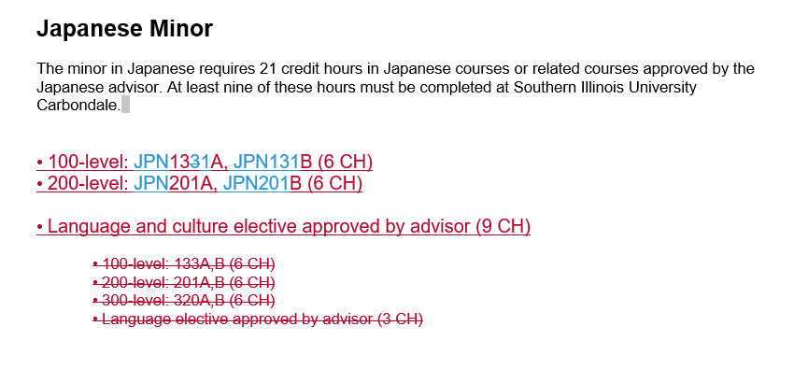
Form 90A Versus RME
Modify a Minor’s Degree Requirements – Form 90A
Eliminate a Minor – RME Approval

Slide 23
Form 90A Versus RME
Modify Catalog Copy– Form 90A
Modify Faculty Listing – Form 90A

Slide 24
FORM 90A VERSUS rme
RME changes should not be included in the same catalog markup as your changes that do not require an RME. The APAP will not process a Form 90A that contains non-approved RME required changes.

Slide 25
Program Description (Form 90A)
Form 90As are due to the APAP Office by no later than October 1st, to be implemented into the next catalog cycle.
Forms received by October 1, 2023 will be included in the 2024-2025 catalog.
Form 90As can be submitted to the APAP Office at anytime. They do not need to be held for the October submission.
APAP and the Registrar are the final approval on these forms.

Slide 26
Process
Director Approval
Curricular Committee Approval (if applicable)
Dean Approval
Graduate School (APAP Office will obtain this signature, if applicable)
APAP Approval (forms due by October 1st)
Registrar Approval

Slide 27
PROGRAM DESCRIPTION (FORM 90A)
Specify catalog – Undergraduate or Graduate
Provide College Name and School/Department Name
Specify the degree to be edited
Provide the Major/Program to be edited
1
2
3
4

Slide 28
PROGRAM DESCRIPTION (FORM 90A)
Include a simple description of what is changing.
Supporting documents are required – Word or PDF files – and should thoroughly describe the requested changes. Use the current catalog page and provide legible markup using Adobe editing tools or Word with tracked changes.

Slide 29
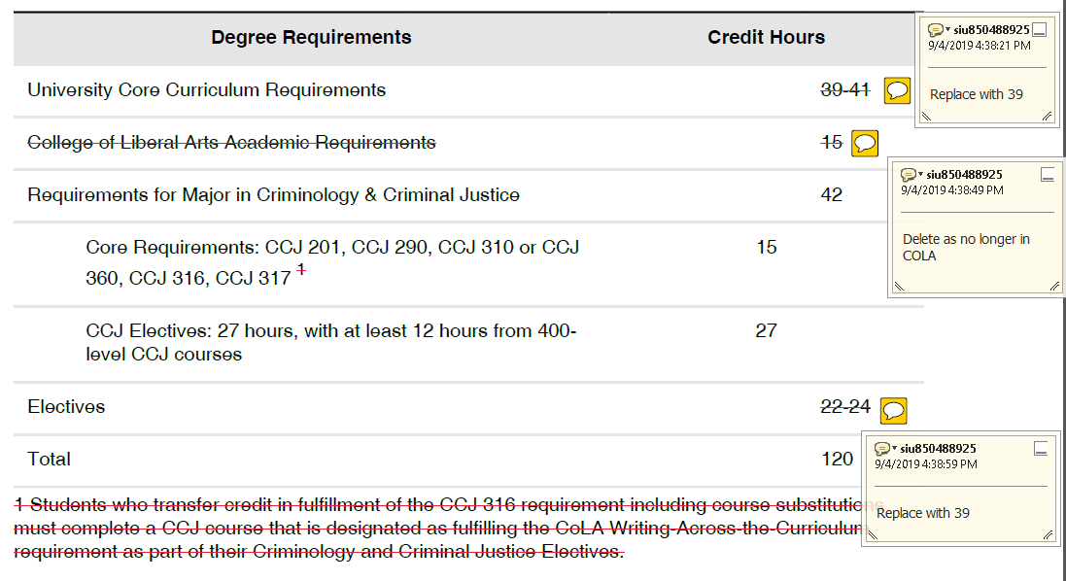
EDITS IN ADOBE
Download pages from catalog and edit using Adobe markup tools

Slide 30
EDITS IN WORD
Create a Word document and use track changes when editing.

Slide 31
signature lines
Form 90As must contain all school/department and college-level signatures before submission to the APAP Office. APAP staff will gather all additional necessary signatures, including Graduate School dean.
Note: Electronic signature of academic officer is required. Staff signatures will not be accepted.

Slide 32
Common Errors
Multiple Form 90As received for the same program page in the same catalog cycle with conflicting edits. Submit one Form 90A for all changes to a program page.
When editing the degree requirements table, make sure the credit hours are still mathematically correct.
Make sure requested edits are clear. You know what the intended changes are. Is it clear to your audience?
Where else in the catalog needs changed? Example: program name change.

Slide 33
Course Description (Form 90)

Slide 34
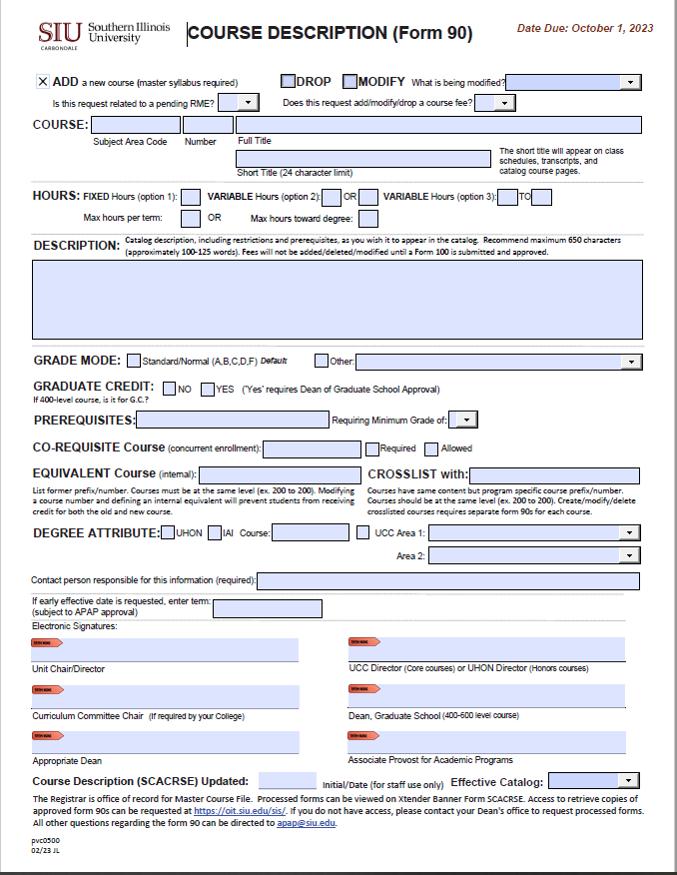
Course description (form 90)
The Course Description (Form 90) is used to add, drop, or modify a course.
Modifications include:
Course prefix, number, or title
Hours
Description
Grade Mode
Prerequisite, Co-Requisite, Equivalent, or Crosslist
Degree Attribute

Slide 35
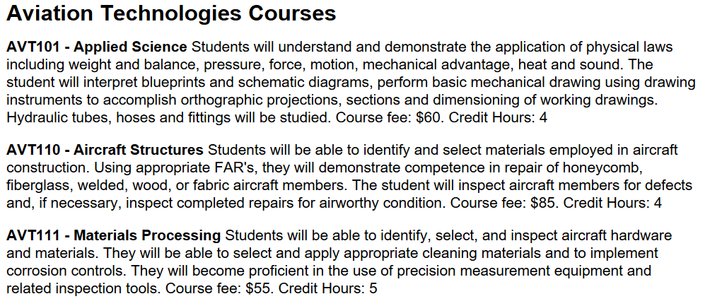
CATALOG COURSE LISTINGS
The ‘Courses’ section of each catalog page is automatically populated from Banner. Any edit for this section requires a Course Description (Form 90).
The Credit Hours automatically populate from banner into the catalog course description. When completing a Form 90, the credit hours should not be included in the course description box.

Slide 36
Course description (form 90)
Form 90s that support degree requirement changes are due to the APAP Office by no later than October 1st.
Form 90s can be submitted to the APAP Office at anytime.
Courses can be added at anytime, and will appear in the catalog for the next cycle.
Courses can be dropped at anytime. The earliest effective term will be the next available term. The course will be removed from the catalog in the next cycle.
Keep in mind that courses that are part of degree requirements, UCC, etc. will need to be dropped in the next catalog cycle. A Form 90A will need to be submitted with the Form 90.
APAP and the Registrar are the final approval on these forms.

Slide 37
Process
Director Approval
Curricular Committee Approval (if applicable)
Dean Approval
Graduate School/UCC/Honors Approval (APAP Office will obtain these signatures, if applicable)
APAP Approval (due by October 1st)
Registrar Approval

Slide 38
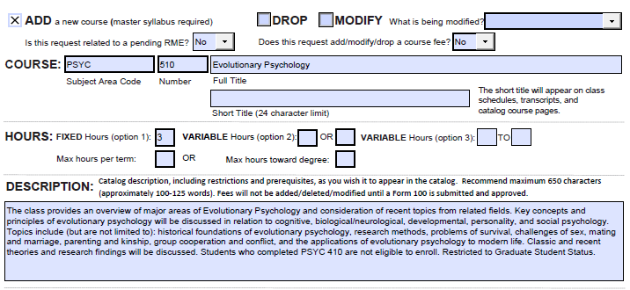
ADD A NEW COURSE
Confirm course number availability with the Registrar’s office. A course number cannot be ‘reused’ for 10 years.
Submit a master syllabus with the Form 90.

Slide 39
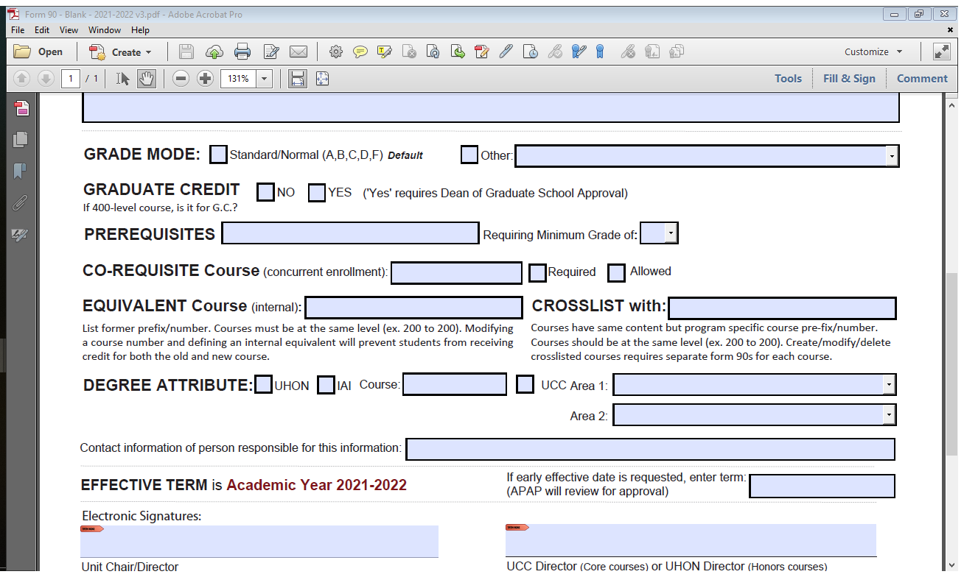
ADD A NEW COURSE
Options:
C Credit/No Credit
D Letter Grade Deferred (Graduate Only)
I Satisfactory/Unsatisfactory/Incomplete (Undergraduate Only)
P Pass/Fail
R Standard/Normal/PR
U Satisfactory/Unsatisfactory/Deferred (Graduate Only)

Slide 40
ADD A NEW COURSE
At SIUC, 400-level courses may be for undergraduates and graduates.

Slide 41
pre-requisites and restrictions
Pre-Requisites – Previous course(s) credit required to support current registration. Include the information listed in the Prerequisite box in the description box as well.

Slide 42
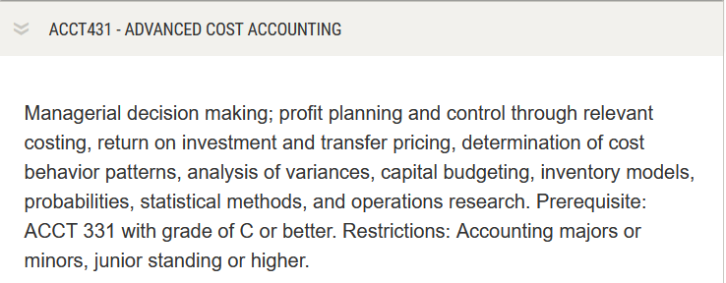
pre-requisites and restrictions Example
This is what will appear in the Courses in the catalog.

Slide 43
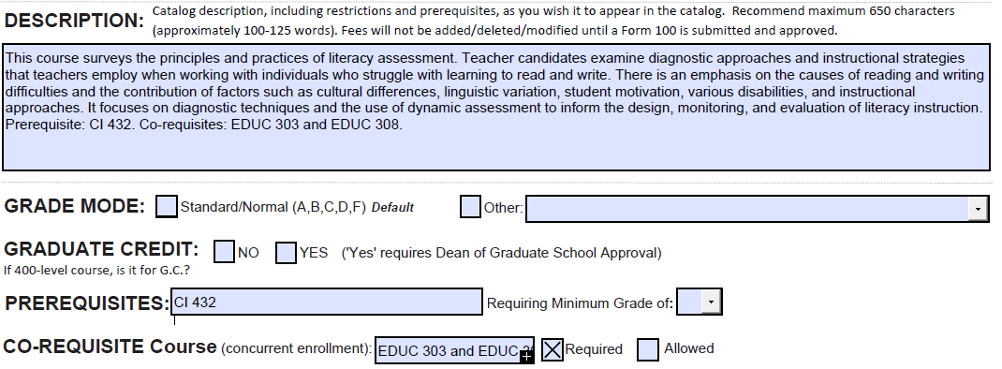
Co-requisites
Co-Requisites - course(s) that are required to accompany registration, what was previously referred to as “Concurrent Enrollment.” Include the information listed in the Co-Requisite Course box in the description box as well.

Slide 44
Co-requisites EXAMPLE
This is what will appear in the Courses in the catalog.

Slide 45
EQUIVALENT AND CROSSLISTED COURSES
EQUIVALENT courses are the former course name/numbers. For example, ITEC 450 and IST 450. A student who has taken IST 450 will not be able to take ITEC 450 for credit.
CROSSLISTED courses meet at the same time and follow the same syllabi but have program specific names/numbers. For example, MHA 510 and MHI 510. Courses must be at the same level and course details must match. A Form 90 cannot be processed until all forms are received.

Slide 46
DEGREE ATTRIBUTE
Specify if the course is Honors, IAI, or part of University Core Curriculum.

Slide 47
SIGNATURE LINES
Form 90s must contain all school/department and college-level signatures before submission to the APAP Office. APAP staff will gather all additional necessary signatures, including Graduate School dean.
Note: Electronic signature of academic officer is required. Staff signatures will not be accepted.

Slide 48
DROP A COURSE
Provide course Prefix, Number, and Name
A separate Form 90 is required for other courses that are associated with this course
crosslisted course
co-requisite course
pre-requisite course
A Form 100 is required if the course being dropped has a course specific fee associated to it.
A Form 90A is required if the course being dropped is listed in the catalog copy and/or degree requirements table.
Confer with other programs that use your courses. A Form 90A may be needed from another academic program if they have the course being dropped in their catalog copy and/or degree requirements table.

Slide 49
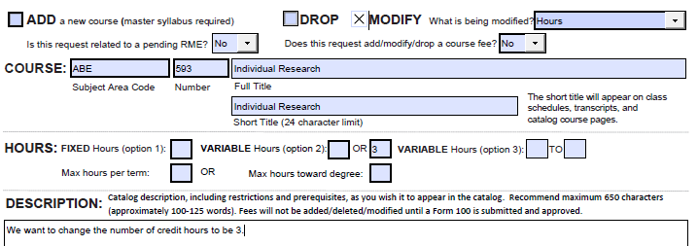
MODIFY A COURSE
Provide course Prefix, Number, and Name
Select the most accurate description from the dropdown menu

Slide 50
MODIFY A COURSE
A Form 90 is required for any co-requisite or crosslisted course associated with the modified course.
MHI 510
When additional Form 90s are needed due to co-requisite or crosslistings for courses outside your program/school, please contact the appropriate director to advise that Form 90s are necessary. Include a copy of your Form 90 and any supporting documentation for their reference. Your Form 90 cannot be processed until all Form 90s are received.

Slide 51
MODIFY A COURSE
When renaming a course – if it is listed on the requirements table or referenced in the front matter of your catalog page, you must submit a Form 90A to rename it.
For example - IST prefix changed to ITEC:
Form 90s submitted to change course names. (Blanket Form 90 appropriate here.)
Form 90A submitted to update catalog page for Information Technology
Additional Form 90As necessary for Electronic Systems Technologies (EST), as IST 209 is listed within their requirements table as an Approved Technical or Career Elective

Slide 52
COMMON FORM ERRORS
Missing approval signatures; support staff cannot sign ‘on behalf of’ a director or dean.
Missing master syllabi – required when adding new courses.
Graduate Credit – you should check yes or no. This prompts APAP staff to submit form to Graduate School for signature.
Degree Attribute – mark if a course has been approved by UHON or UCC. This prompts APAP staff to submit form for to UCC or Honors for signature.
Co-Requisite, Equivalent, or Crosslisted courses should be listed on the Form 90. Accompanying Form 90s for these courses are required.
Include Prerequisites and Co-Requisites in the description box.
An Equivalent course is a former course. Crosslisted courses are current courses that have the same content.
When defining a prerequisite, EDUC XXX, PHIL XXX = EDUC XXX and PHIL XXX

Slide 53
COMMON FORM ERRORS
When DROPPING a course – if it is a pre-requisite for another course XYZ, a Form 90 is needed for course XYZ to remove it as a pre-requisite.
When DROPPING a course – if it is listed on the requirements table or referenced in the front matter of your catalog page, you must submit a Form 90A to remove it.
When renaming a course – if it is listed on the requirements table or referenced in the front matter of your catalog page, you must submit a Form 90A to rename it.
We recommend that you download the forms and fill it out using PDF software. The form is not designed to be filled out within a web browser.
A Form 90 is required to modify a course listing in the catalog. A Form 90A is not needed.
Courses listed in the catalog should be reviewed. Those no longer offered should be eliminated.
Courses on the schedule of classes should be reviewed. Courses that will not be offered should be removed. They can be added back to the schedule with a Form 75.

Slide 54
In addition…
iTransfer (https://itransfer.org/) Source of IAI numbers as well as information on transfer of coursework in the State of Illinois
Additional tutorials related to catalog processes and program reviews at SIUC (https://pvcaa.siu.edu/associate-academic-programs/tutorials.php). Includes guidelines for developing a master syllabus.
Office of the Registrar: registrar@siu.edu

Slide 55
Contacts
APAP Office
Associate Provost for Academic Programs
Melissa Laake, Office Administrator
apap@siu.edu
453-7653
Registrar Office
Suzanne Goad, Master Course File, Degree Works, Program Articulation Degree Reviews
sgoad@siu.edu
453-7134

